Slide 1
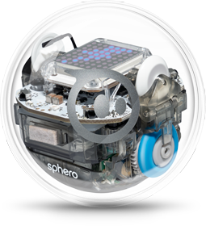
Sphero Y4
Lesson 1

Slide 2
Explain to your partner how to connect Sphero to the iPad.
What can we manipulate using Sphero?
Starter

Slide 3
Learning Objectives:
To be able to debug simple sequences
To use if/then/else statements
To explore different sensor inputs build in Sphero
To be able to layer these skills and build a game

Slide 4


What do you think the main differences will be?

Slide 5
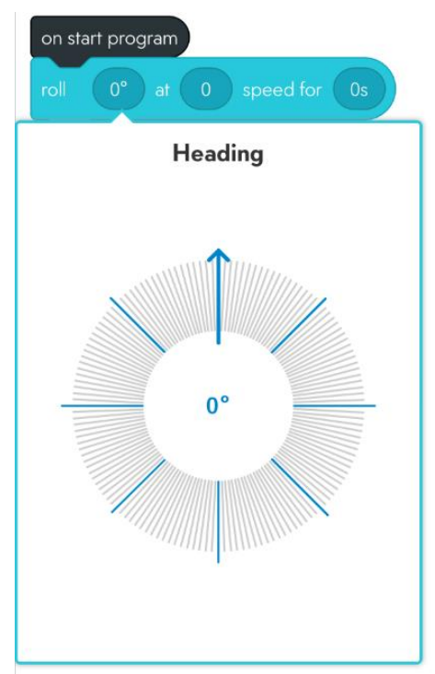

Basics of Sphero Edu
How to pair Sphero with the iPad
Opening a new program
Aiming
Basic movement principles of movement
More code blocks

Slide 6

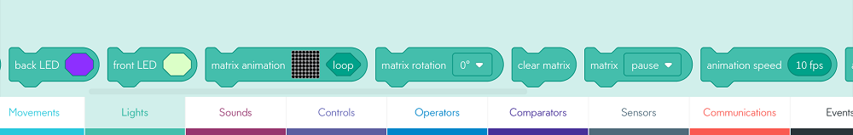
7 Minutes of Play
In Pairs, can you:
Change the colour on the matrix?
Get Sphero to make a noise?
Get Sphero to move away from you and then come back?

Slide 7
What does it mean to ‘debug’ code?

Slide 8
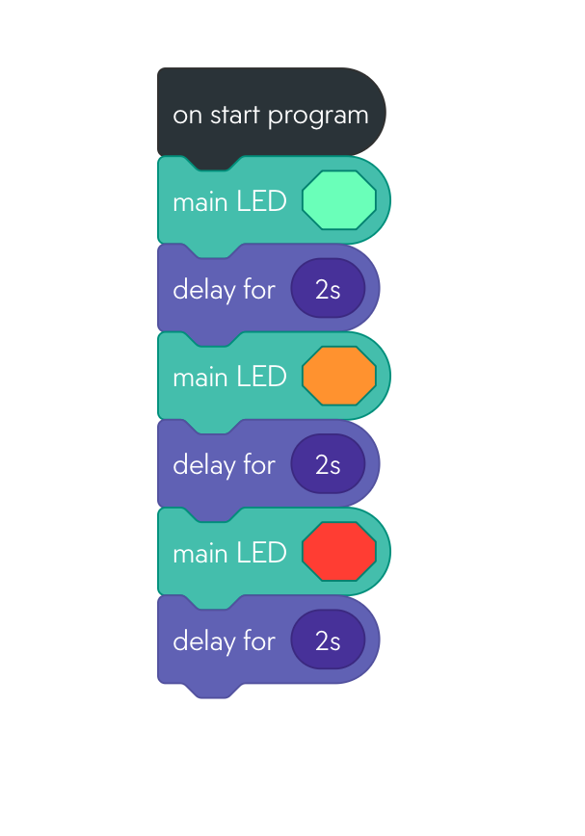
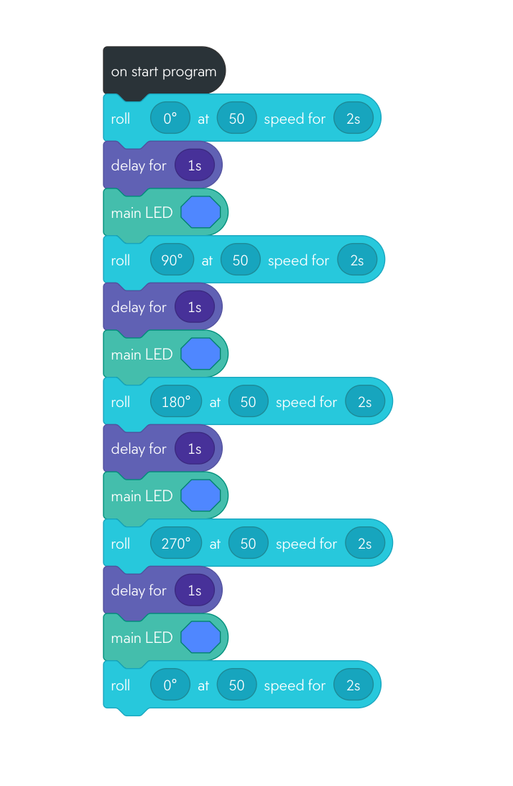
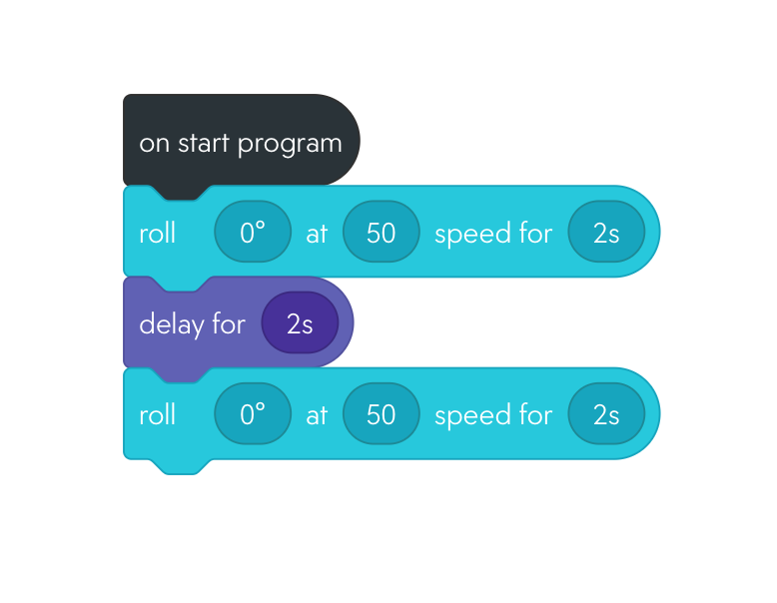
In this code, Sphero is supposed to roll away from me and then back towards me, can you fix it?
This code is supposed to go through the traffic lights on a loop, what’s missing?
This code is supposed to change colour at each point in the square, what is wrong?
Notes:
What is wrong with each code? Can they build it and show it working properly?

Slide 9
Sphero Y4
Lesson 2

Slide 10
What does it mean to ‘debug’ a sequence of code?
Starter

Slide 11
Learning Objectives:
To be able to debug simple sequences
To explore different sensor inputs build in Sphero
To use if/then/else statements
To be able to layer these skills and build a game

Slide 12
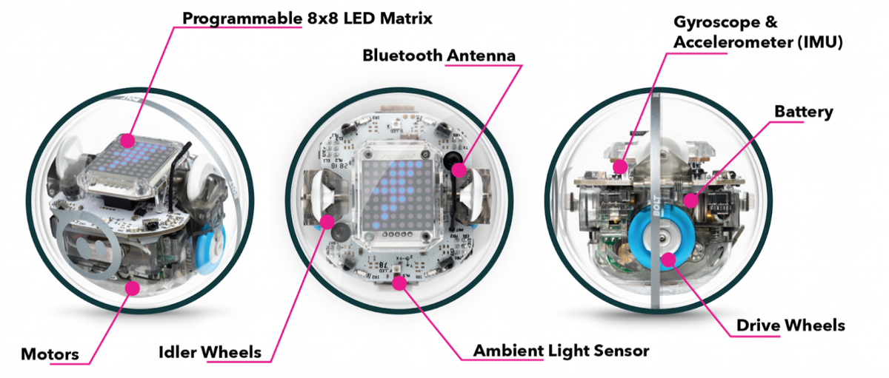
What do you think this sensor will measure?

Slide 13
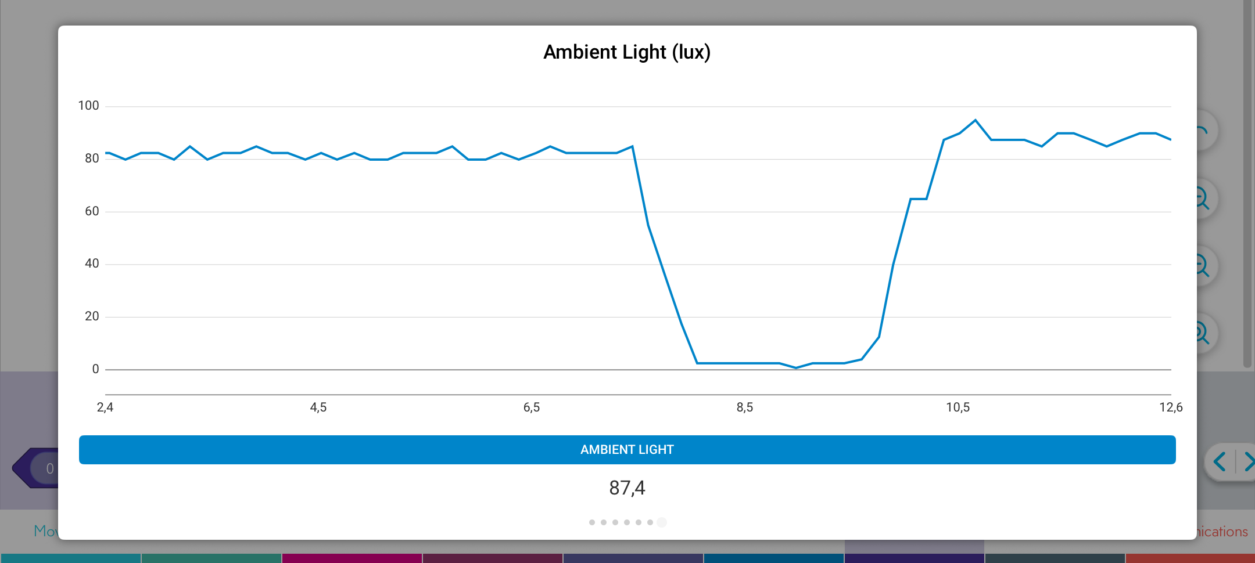
Let’s play with the thresholds….
What is the level of ambient light in the Dreams Lab right now?
What number does it reach if you put one hand on top?
2 hands?

Slide 14
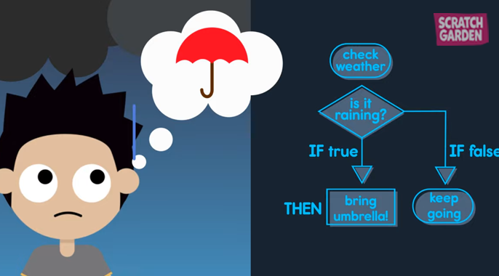
Conditional logic - If/then/else

Slide 15
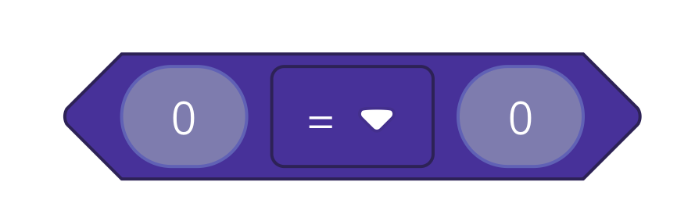
Conditional logic
Ambient light is less than 50
If else (not true)
If true
Light turn blue
Light on green
Can you build this code to continue forever?

Slide 16
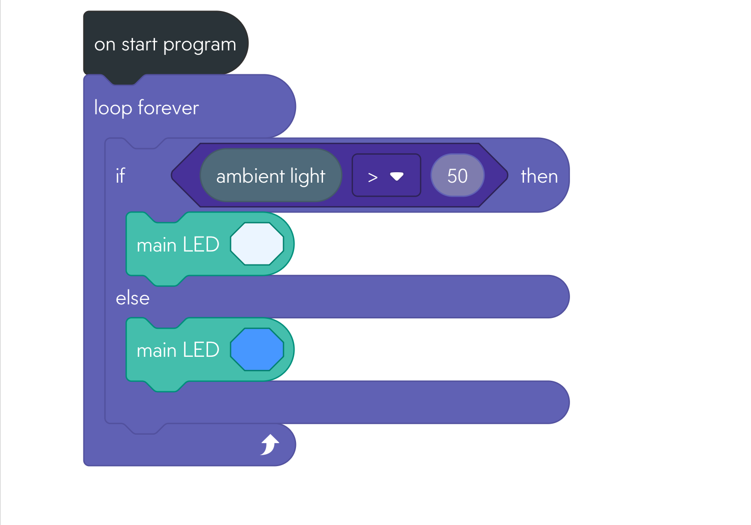
Code solution

Slide 17

Time to use your imagination!
We are going to turn Sphero into a ….
Notes:
What conditions to cockroaches like best? Video to demonstrate - need to build a cockroach cage in the tech cave where darker

Slide 18
Conditional logic
Ambient light is More than 100
If else (not true)
If true
The cockroach is calm and still - Light on green
The Cockroach panics and zooms around randomly
Read this conditional statement to your partner.
What do we want our cockroaches to do?

Slide 19
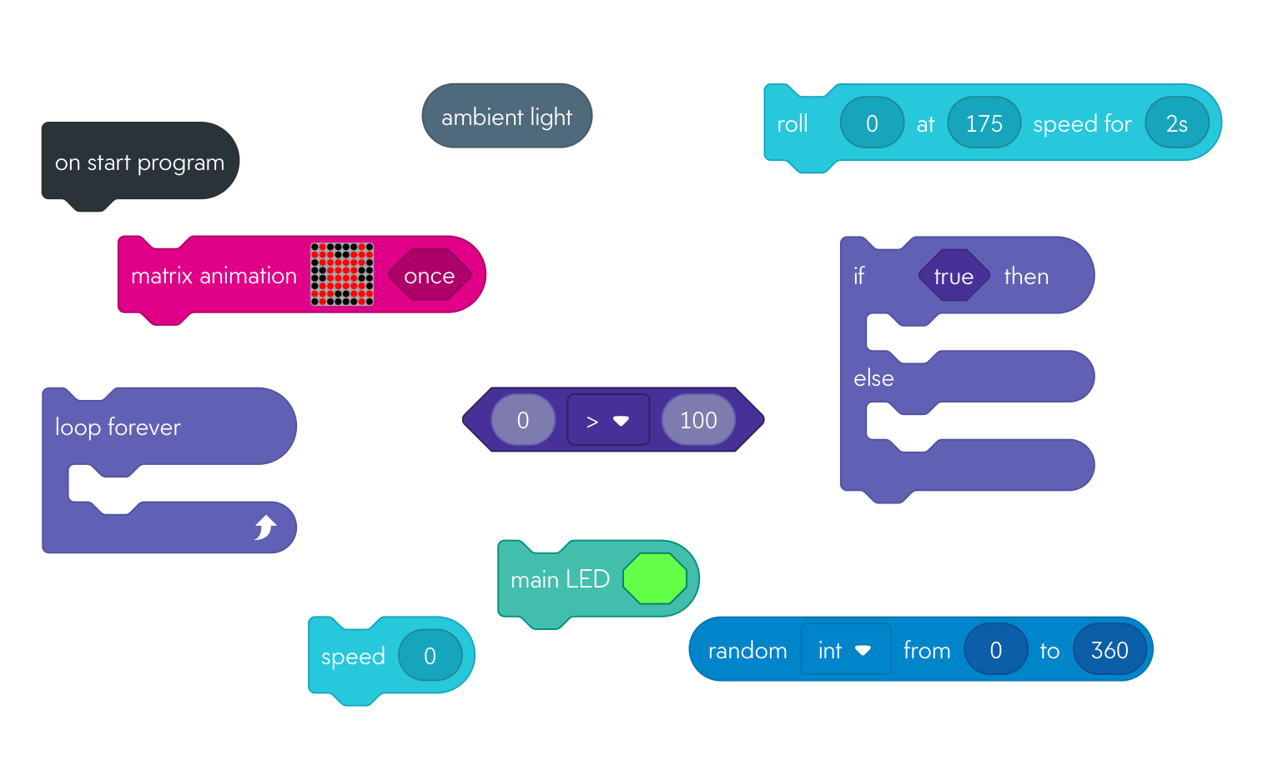
Use these code blocks:

Slide 20
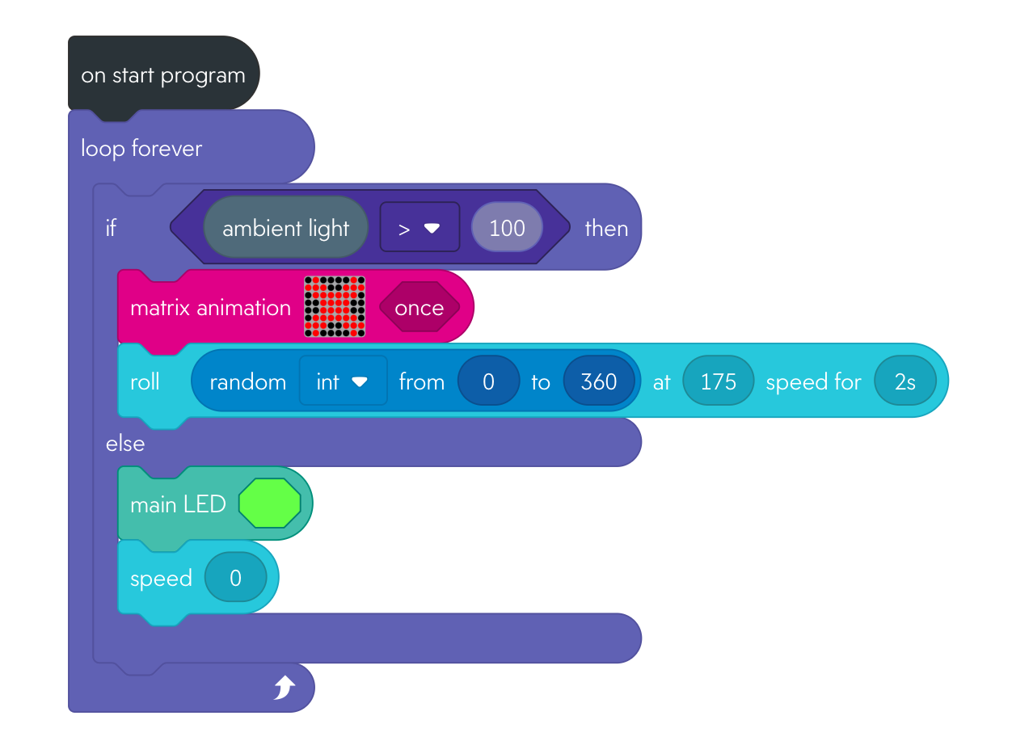
Code solution:
Let’s test them in the tech cave!

Slide 21
Plenary
Learning Objectives:
To be able to debug simple sequences
To use if/then/else Conditional Logic statements
To explore different sensor inputs build in Sphero
To be able to layer these skills and build a game
Can you use the key words from the LOs to explain what the cockroaches did and how you built the code?

Slide 22
Sphero Y4
Lesson 3 - animal toss

Slide 23
Tell your partner what a conditional statement is and give an example.
If….then/else
Starter

Slide 24
Learning Objectives:
To be able to debug simple sequences
To explore different sensor inputs build in Sphero
To use if/then/else statements
To be able to layer these skills and build a game

Slide 25
What do you think this sensor will measure?

Slide 26
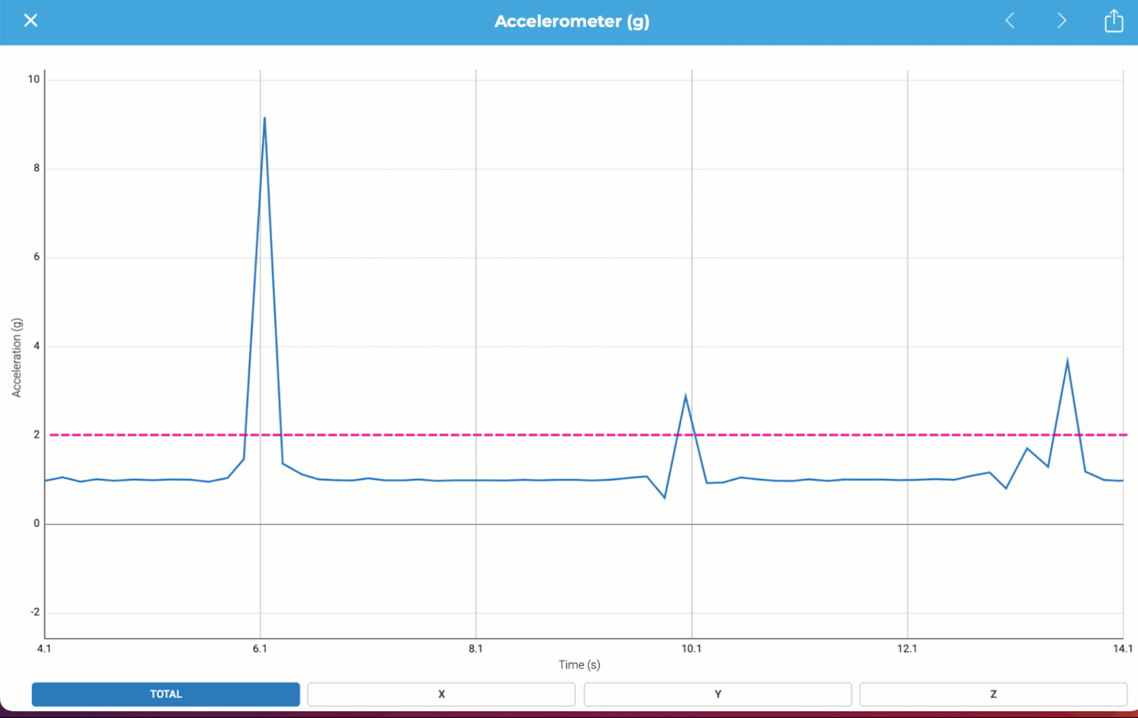
Let’s play with the thresholds….
What is the level when Sphero is still?
What is the level when you shake it gently?
What is the level when you shake it hard?

Slide 27
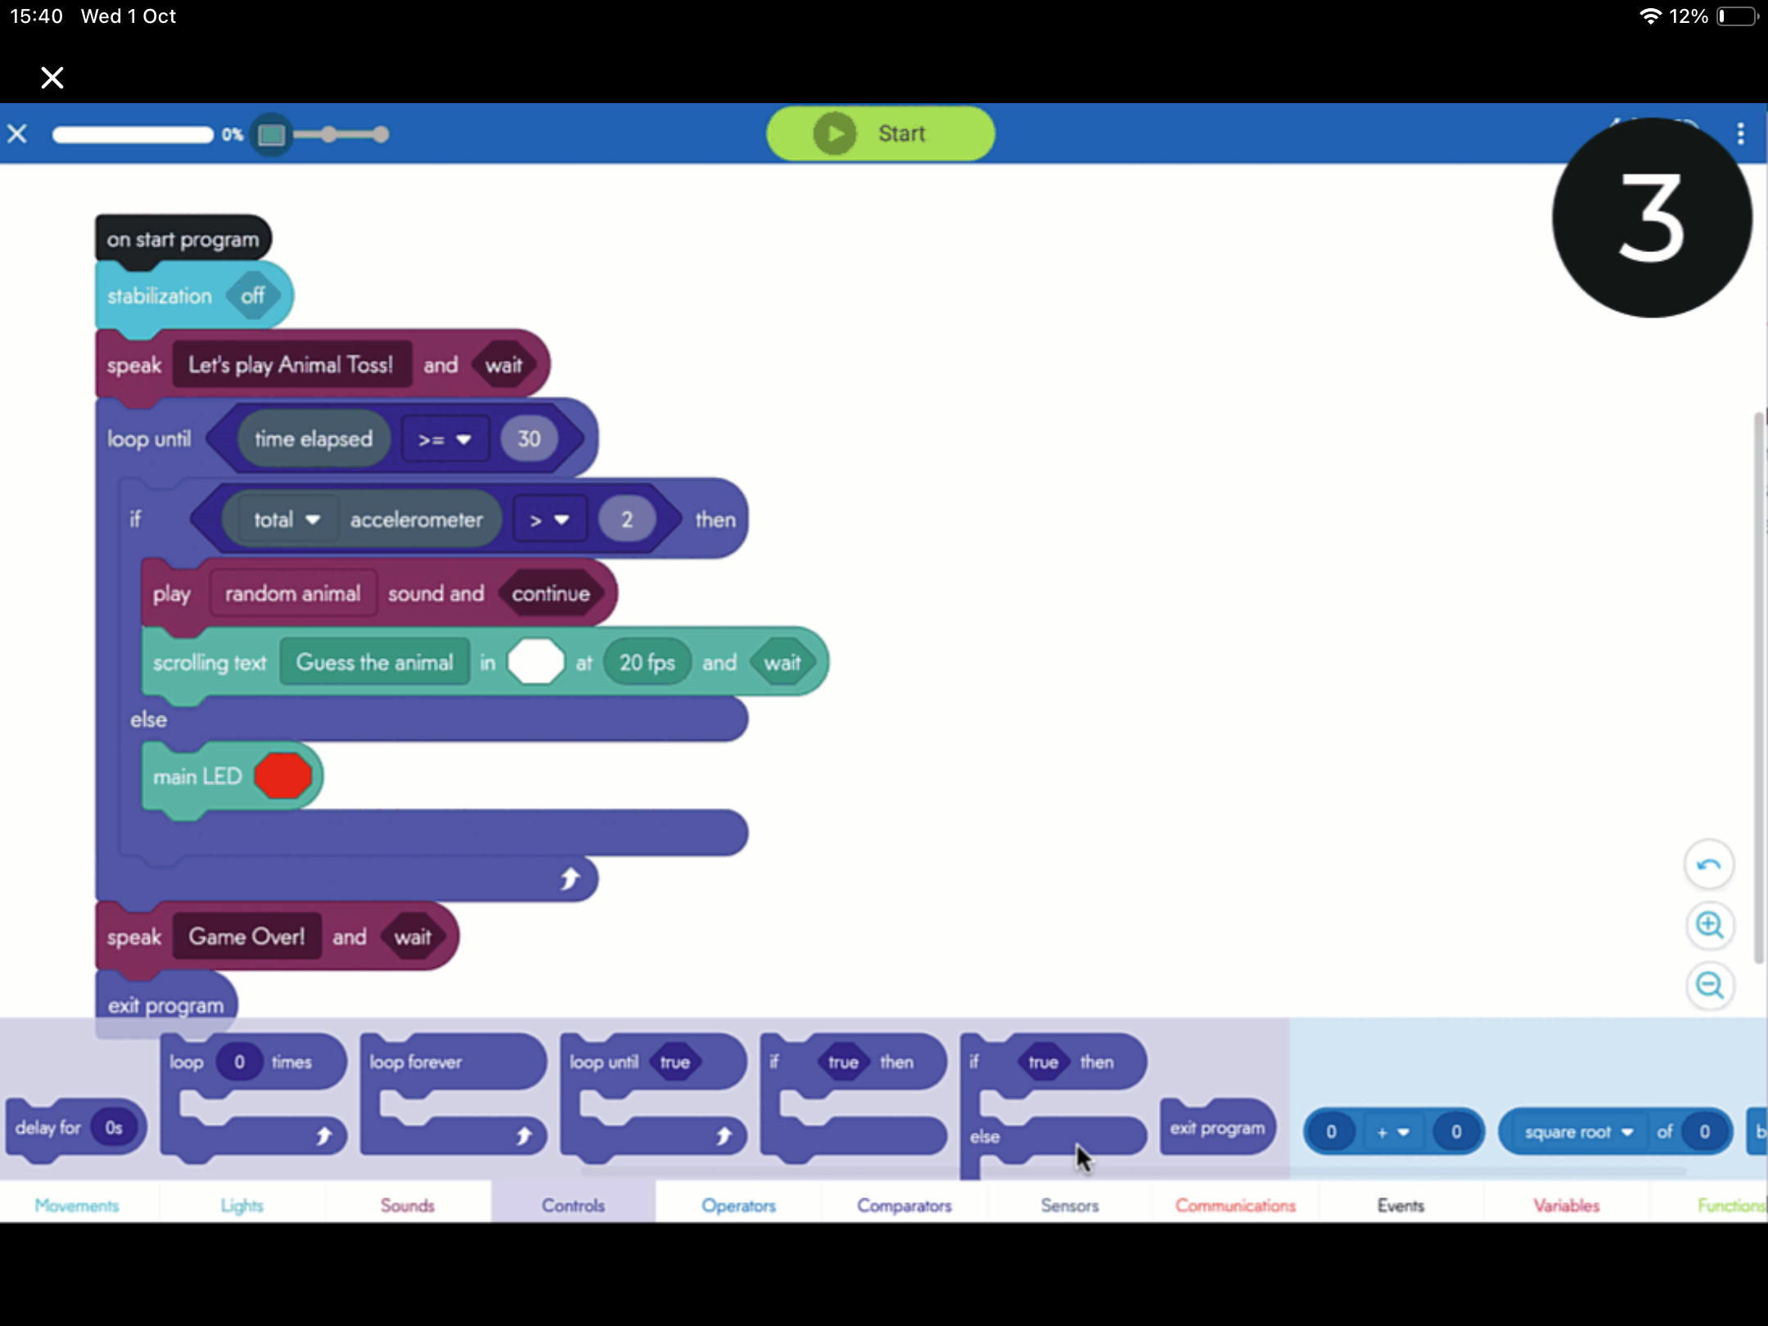
Can you build the game?
Accelerometer is greater > 2
If else (not true)
If true
A random animal sound + Scrolling “guess the animal”
Light on green
Can you add a loop for 30 seconds?

Slide 28
Let’s play!!

